Slide 1
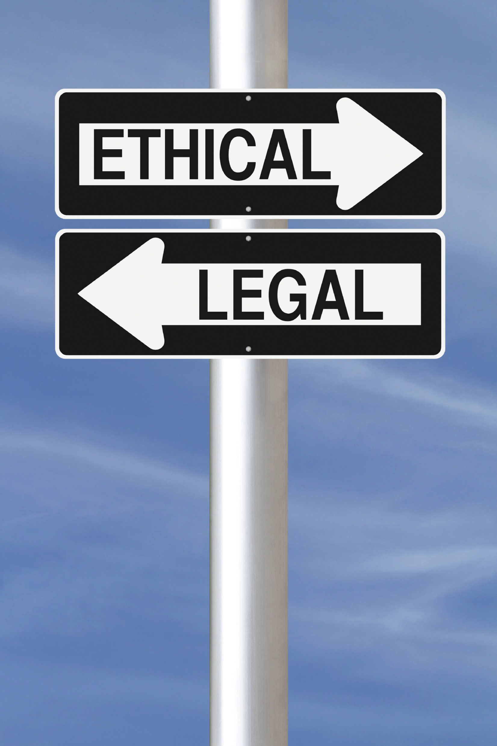
Ethical and Legal Consideration in IOT

Slide 2
What is IOT?
IOT is system of interrelated computing devices which communicate with each other according to the environment and makes world a better place of living.

Slide 3
IOT Technologies and Characteristics
RFID (Radio Frequency Identification)
Different sensors
GPS (Global Positioning Solution)
NFC (Near Field Communication)
3G/4G

Slide 4
RFID (Radio Frequency Identification)
Radio-frequency identification uses electromagnetic fields to automatically identify and track tags attached to objects. The tags contain electronically stored information. Uses electromagnetic fields to automatically identify objects, by labeling them with a chip or two antennae, called “tag”.
Sends a unique electronic code which is read by a reader which can be placed anywhere.
Used to automatically track objects, including those attached to people (ski pass, driving license, time tags, bracelets for pupils) .

Slide 5
Sensors
Sensors are sophisticated devices that are frequently used to detect and respond to electrical or optical signals. Play a very important role in establishing the relationship between the virtual world and the parameters of the physical world. Types includes temperature sensor, ambient light, accelerometers and others.
Smoke sensor used to detect smoke.
Pollution level of water can be detected
Attached to robots which can be used to save life in natural disaster or by army in ware place.

Slide 6
GPS (Global Positioning Solution)
A system controlled and financed by the American Department of Defense.
Uses satellites to monitor (vertically and horizontally) the position held by a user.
Can be used anywhere in the world, including on planes and ships.
GPS receptors estimate the position according to the satellites which orbit the earth at a speed of approximately 3 km/ s.

Slide 7
NFC (Near Field Communication)
A radio device, which can establish the communication between two objects which are in an area of up to 20 cm.
Uses:
In contactless payments.
Sharing information in social networks.
Replacing identity cards or door keys.
Payment devices for public transport networks

Slide 8
3G & 4G
Acronym used for the third generation of mobile phones.
Used to transfer voice and data (including videos) .
Allows downloading software, email and instant messaging communication.
4G is a combination between 3G and WiMAX.
Note: WiMAX (Worldwide Interoperability for Microwave Access) has a larger coverage area and a wider band than Wi-Fi.

Slide 9
Ethics in IOT
Ethics refers to the legal framework of determining appropriate behavior of autonomous IOT entities.
Ethical values specifies what is right or wrong/moral or immoral or what is prohibited in the society.

Slide 10
Law vs Ethics
Law and ethics are overlapping, but ethics goes beyond law.
Law is defined as the set of rules produced by the government which specify what a person must or must not do.

Slide 11
General Issues with IOT
Protection of privacy
Data security
Data usability
Data user experience
Trust
Safety, etc.

Slide 12
IOT characteristics that may cause Ethical Problems
Ubiquity
The IOT is everywhere. The user is attracted to IOT, absorbed by it; there is no clear way out.
Difficult identification
The access to these objects and the management of their identities might cause crucial problems of security and control in the IOT ecological world.

Slide 13
Autonomous and unpredictable behaviors
Interconnected objects might interfere autonomously and spontaneously in human activities in unexpected ways for the users.
Ultra-connectivity
The huge number of connections of objects and people require the transfer of large quantities of data (big data) which could be maliciously used.

Slide 14
IOT Ethics Questions
What happens if the internet connection break down?
Who is responsible or liable for patching IOT devices, routers and cloud connections?
Who owns the data collected by IOT devices?
What happens when these devices fails during critical situations?

Slide 15
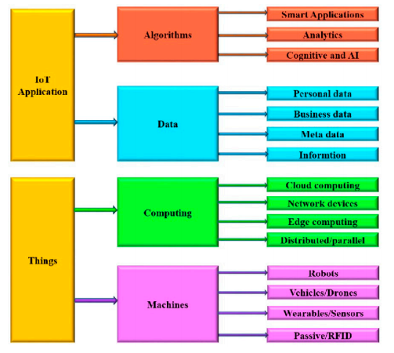
Security, Privacy and Trust Issues

Slide 16
Privacy
Privacy is the most murdered by IOT. The privacy framework should include:
Privacy regulations.
Data minimization.
Data portability.
Transparency.
Compliance disclosures.

Slide 17
Security
The concepts of security and privacy have many common interrelationships, but they are not identical. A typical misconception refers to the identification of confidentiality with privacy.
Hofkirchner’s possible relations between security and privacy are on basis of:
Reductionism.
Projectionism.
Dualism.
Dialectic.

Slide 18
Trust
Trust can be looked-up from different views and interpretations. A trust framework should provide general principles for dealing, besides security, privacy and safety, with the following issues:
Trustworthiness
Dependability
Sustainability
Reliability
Availability
Resilience

Slide 19
Aspects that can assure high level of trust
Trust is fundamental in all human–human and human–technology interactions (economic, business, social, political, and so on).
Basic aspects are:
Good reputation
High transparency
Proper education

Slide 20
Benefits of Ethical Leadership
Reduces business liability.
Helps employees make good decisions
Assures high-quality customers services
Prevents costly administrative errors and rework
Consistently grows the bottom line.

Slide 21
Thank You!

